Slide 1
Linnaean Classification

Slide 2
By the end of the lesson, you should be able to:
1. | Recall how the scientist Carolus Linnaeus, also known as Carl von Linné, contributed to modern taxonomy.
2. | Explain what taxonomy is.
3. | Present the seven levels of the Linnaean system of classification.

Slide 3

Taxonomy is the science or technique of classification.
Carolus Linnaeus was a Swedish botanist and zoologist - he studied animals and plants.
He is known as the father of modern taxonomy for his work on classifying living things.

Slide 4
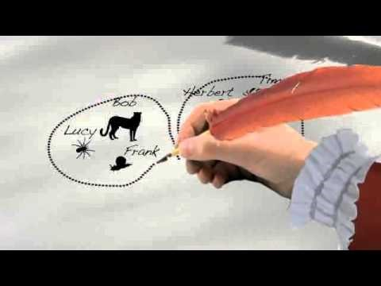

Slide 5
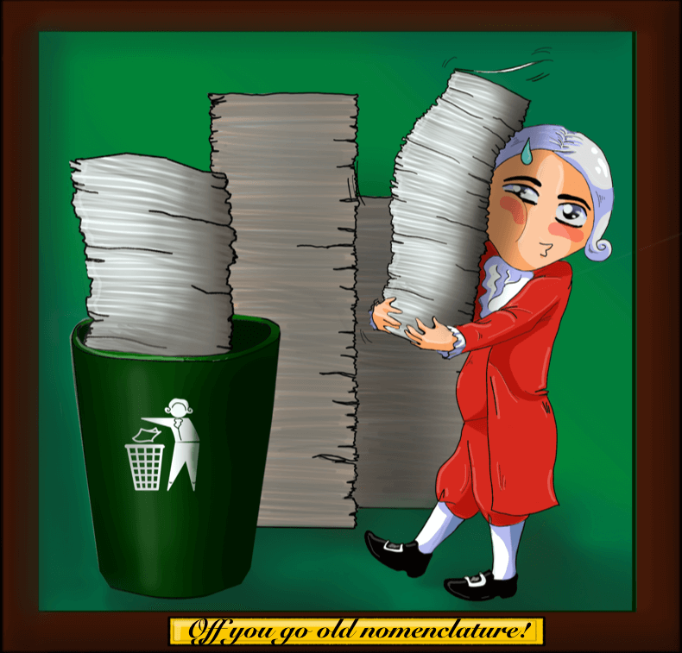
Linnaeus also invented the binomial naming system which we use today.
This is known as binomial nomenclature. It simplified tremendously the names for every organism, which used to be very long.
It's a two-part naming system, that uses Latin words to name a species. The first word is the genus and the second word is the species name.

Slide 6
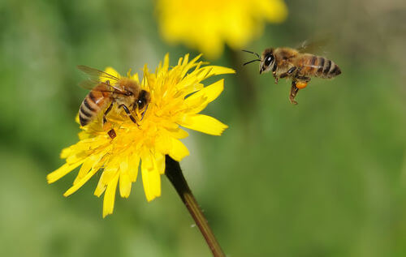
For example, the honey bee is known as Apis mellifera.
The honey bee belongs to the genus Apis and mellifera means the species is "honey-bearing".

Slide 7
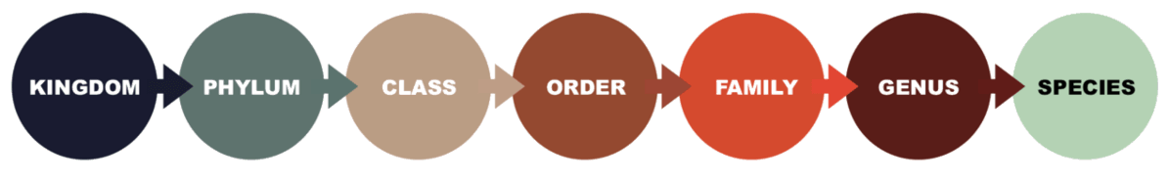
Linnaeus devised a classification system that has seven levels.
It begins with the kingdom level, which includes the largest number of organisms.
The last level is species, which is a very specific group of related organisms.
These are the levels in between:

Slide 8
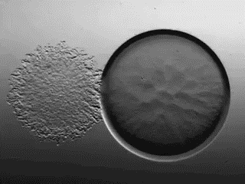
Although we still use Linnaeus' system today, we have updated it.
The invention of the microscope allowed scientists to discover microorganisms and different types of cells.
This is why now there is also a level above Kingdom, called Domain. It separates for example bacteria from organisms like plants and fungi.

Slide 9
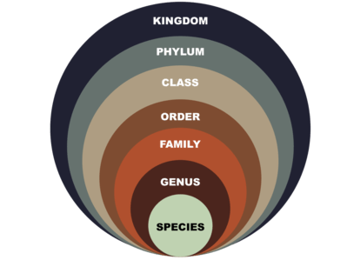
A great way to remember the order of the levels of classification is to use a mnemonic!
This is a sentence where the first letter of each word matches the first letter in a level of classification.
King | Phillip | Cried | Out | For | Good | Soup
Kingdom | Phylum | Class | Order | Family | Genus | Species

Slide 10
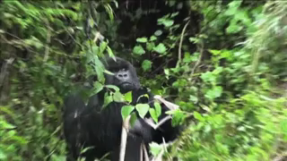
The first group in the levels of classificiation is Kingdom.
Organisms are classified into kingdoms based on features such as how they gain nutrition and the cells that make up their bodies.
For example a gorilla is in the Animalia kingdom. It feeds itself by eating other organisms (such as fruit from plants), just like every other animal.

Slide 11
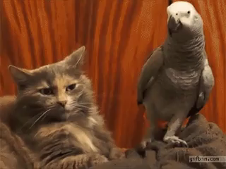
The second level of classification is the Phylum (plural phyla).
The organisms within a phylum have more similar characteristics than at the kingdom level. They are more closely related to each other.
Cats and birds are both in the phylum Chordata, which includes all animals with backbones!

Slide 12
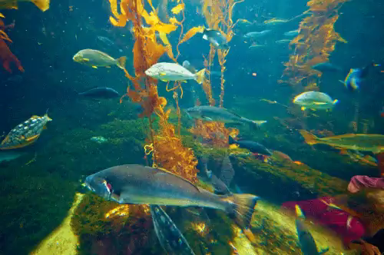
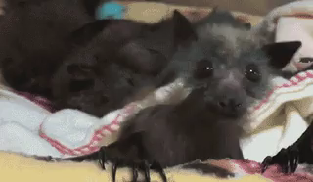
The next classification group is Class.
This classification group splits organisms into groups such as fish and mammals.

